Slide 1

Optimizing Inventory Setting
Presented by Tzuying Yu​

Slide 2
Agenda & Objective
Objective
Reduce back orders and optimize inventory settings by aligning reorder points, safety stock, and lead times with each product’s demand pattern.
Agenda
Context — back-order trends and key components of demand planning
Inventory settings: reorder point, lead time, safety buffer, preferred stock level
Target products and issues raised by Product Management
Demand-pattern segmentation (Syntetos & Boylan): Smooth, Intermittent, Erratic, Lumpy, Sparse
Action plan by department — Demand Planner, Sales & Marketing, BI
Q&A

Slide 3
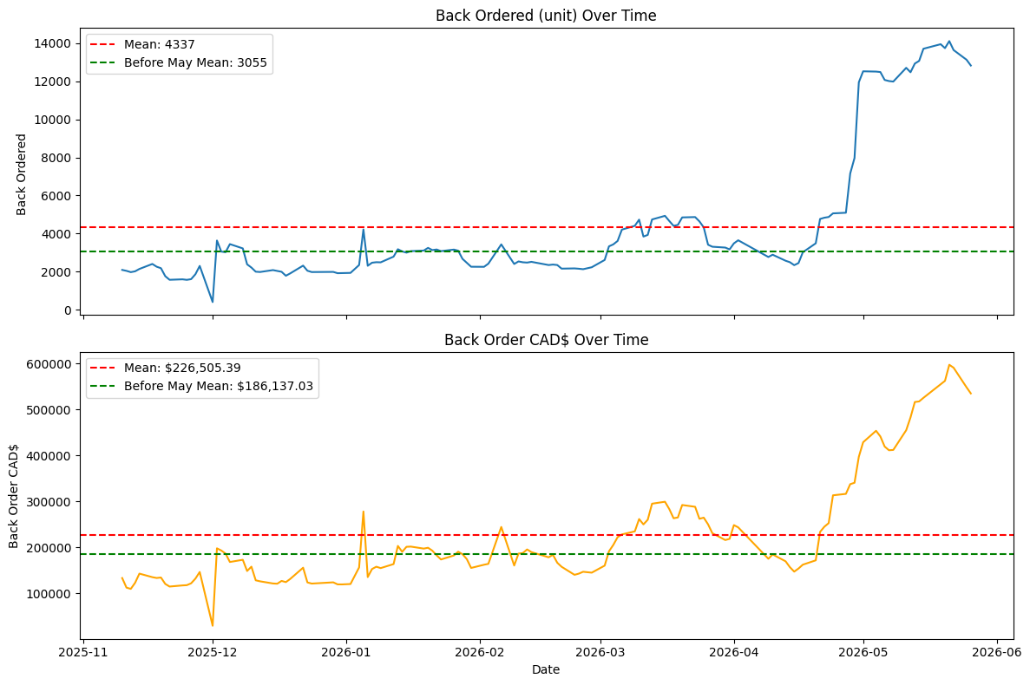
Back Order
2025-11-10 to 2026-05-25
4,337
Avg. Units in Back Order
$226,505
Avg. Value in Back Order
ONLY Main Warehouse
Exclude Wholesale SO
What the chart shows
Average daily Units back-ordered held near the 3,055 pre-May from Nov 2025 through April 2026
Volume ramped sharply from beginning of May 2026 and peaked at ~13,500–14,000 units in late May — roughly 3× the prior baseline, pulling the overall mean to 4,337.
Back-order value (CAD$) tracks the same pattern: pre-May mean ~$186K, climbing to a ~$590K peak by late May (overall mean $227K).

Slide 4
Key Components of Demand Planning
Step 01
Product Management
Up-to-date product info
Step 05
Monitor & Improve
Learn, refine, repeat
Step 02
Statistical Forecast
History sets the baseline
CYCLE
OF DEMAND
PLANNING
Step 04
Promotions
Plan for demand spikes
Step 03
Sales Overrides
Capture market input

Slide 5
Introducing to Inventory Setting:
------------------------
Reorder Point
Lead Time
Safety Buffer
Preferred Stock Level
Inventory Setting
Per-item replenishment rules that tell the system when and how much to reorder for each location.
Reorder Point (Min)
Stock threshold that triggers reordering — (Avg Daily Sales × Lead Time) + Safety Buffer.
Lead Time
Days from placing the order to receiving stock. Vendor-specific and informed by demand planner.
Safety Buffer
Extra units held to absorb demand spikes and supplier delays — protects against stock-outs.
Preferred Stock Level (Max)
Target on-hand quantity after replenishment. Reorder Point + ( Avg Daily Sales × Review Cycle Days). Therefore, PO size = Max − on-hand − incoming.
Of the 27,737 active items in NetSuite, only 48.5% (13,454) have ever sold. A single inventory policy won’t fit every item, but tuning settings item-by-item isn’t realistic either — grouping products by demand pattern lets us apply the right rule to each class efficiently.

Slide 6
Target Products
1,368
Top Products (Focus)
9407
Sold at least once since 2025 (exclude D2)
Top
Revenue
Using sales since 2025 as the baseline, items are ranked on three dimensions: the 80/20 rule defines top revenue and top margin, while top quantity is the 1,000 items with the highest units sold.
207
36
176
Top
Margin
Top Revenue —Pareto 80/20 rule by sales $
80% of 2025 sales came from top 12.62% items. The rest of 20% 2025 sales were composed by bottom 87.38% item. The 2025 sales concentrated heavily on the top 1034 items.
482
19
169
Top Margin — Pareto 80/20 by margin $
80% of 2025 margin came from top 9.08% items. The rest of 20% 2025 margin were composed by bottom 90.92% item. The 2025 sales concentrated heavily on the top 744 items, which far exceeds the Pareto 80/20 rule.
Top
Quantity
330
Top Quantity — 1,000 highest by units
The mean quantity of the top quantity is 490.51 with std of 1474.63, and median of 90, max of 31281 and min of 55. In other words, there are few outliers that raise the average.
1,419 Top Products (Focus) • 482 hit all three lenses
Three Dimensions VENN Diagram

Slide 7
Issues Raised by Product Management
27,737 Active Items
Finding
Of the 1,419 Top Products identified from 2025 sales, 145 (~10.14%) are flagged inactive in NetSuite.
Most carry labels like “OLD – DO NOT USE” — not retired through the normal phase-out cycle but duplicate item profiles.
Impact
Duplicate profiles fragment sales history, making the same product hard to identify and breaking continuity for demand planning and trend analysis.
“Order Items” Page embedded in NetSuite only show active item.
Recommendation
Tighten product-management practice so a single item carries its full history — enabling accurate forecasting and clean trend analysis.
9,407
sold once since 2025-01-01
1,419 Top Product
*145 lost due to inconsistent product management
1,274 Top Product

Slide 8
Quantitative Forecasting
Goal: Define

Slide 9
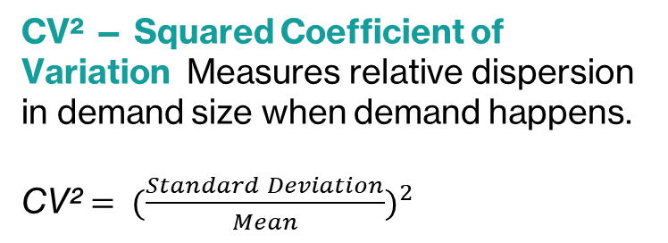
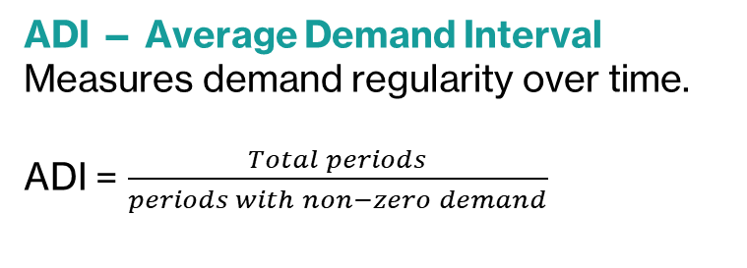
Syntetos and Boylan Classification for Demand Pattern
ADI — Average Demand Interval Measures demand regularity over time.
ADI = $\frac{Total periods}{periods with non−zero demand}$
Erratic
Lumpy
CV² — Squared Coefficient of Variation Measures relative dispersion in demand size when demand happens.
CV² ${= (\frac{Standard Deviation}{Mean})}^{2}$
CV² 0.49
Smooth
Intermittent
ADI 1.32
Items split at the theoretical thresholds ADI = 1.32 and CV² = 0.49 into Smooth, Intermittent, Erratic, and Lumpy — each needing a different forecasting and replenishment approach. However, thresholds should be tuned to the industry and business context.
Citation: Syntetos, M & Boylan, John & Croston, JD. (2005). On the categorization of demand patterns. Journal of the Operational Research Society. 56. 10.1057/palgrave.jors.2601841.

Slide 10
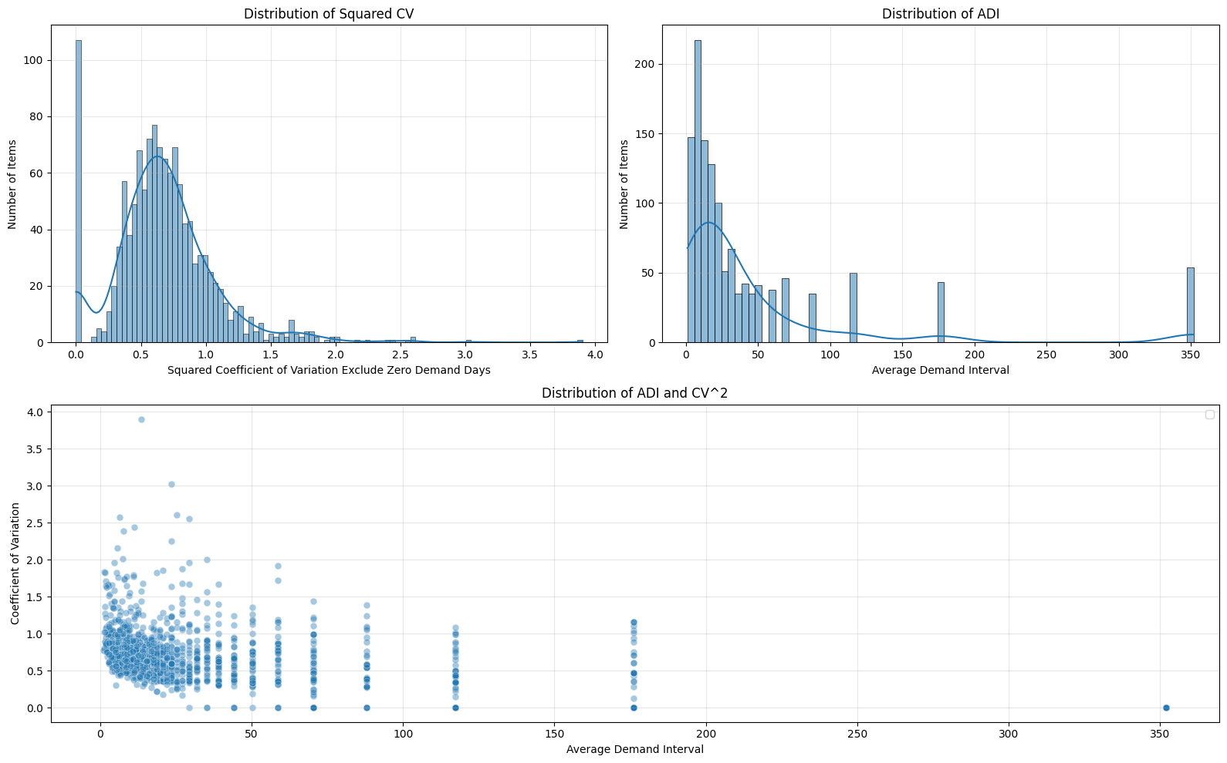

Slide 11
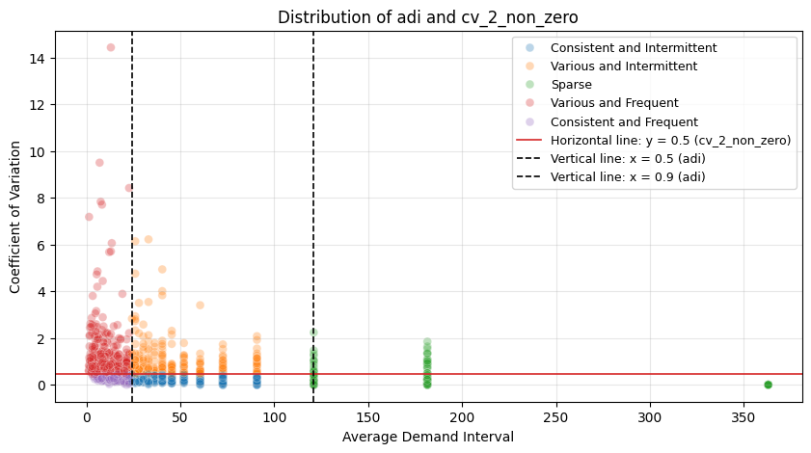
Top Product Segmentation by Demand Pattern
Various and Frequent - Erratic
402
Consistent and Intermittent - Intermittent
278
Consistent and Frequent – Smooth
235
Various and Intermittent – Lumpy
212
Sparse
147
Total
1,274
- ADI = 20.13 means that from last year till today, the sales happened around 18 days.
- ADI = 117.33 means that from last year till today, the sales happened around 3 days.

Slide 12
Smooth
Low ADI (Frequent) · Low CV² (Consistent)
Forecast Mean = Syntetos –Boylan Approximation ( α = 0.2 )
Review Cycle Demand = Review Cycle × Forecast Mean Demand
Safety stock: bootstrapping samples, 70th percentile – average demand over Review Period + Lead Time
Lead Time (days) is fixed, provided by demand planner.
Lead Time Demand = Lead Time (days) × Forecast Mean Demand
Reorder Point = Lead Time Demand + Safety Stock
Preferred Stock Level = Reorder Point+ Review Cycle Demand

Slide 13
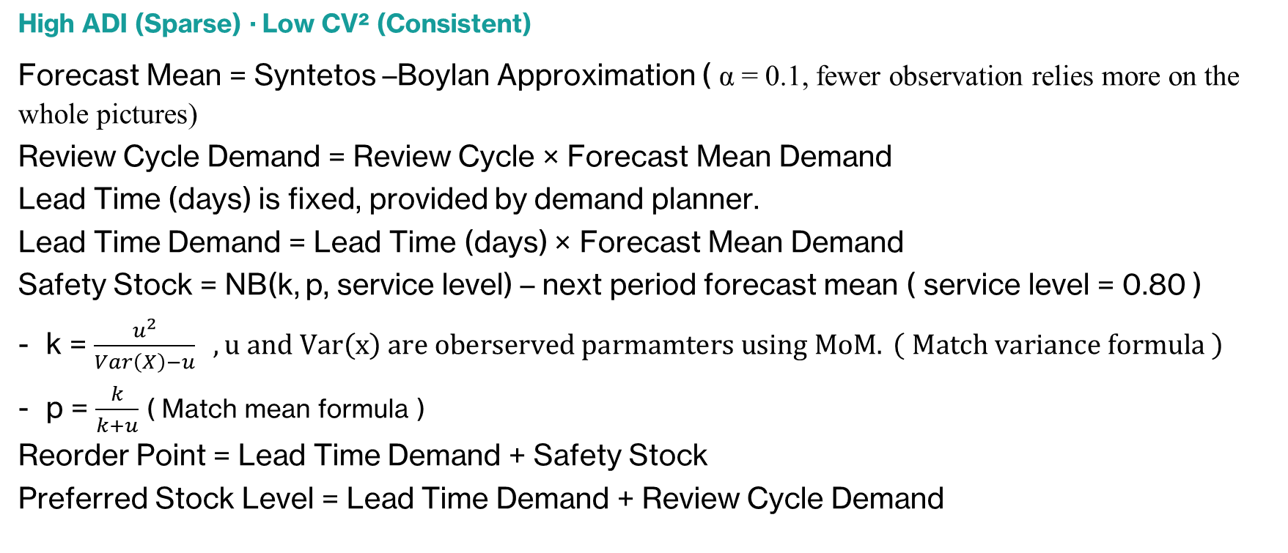
Intermittent
High ADI (Sparse) · Low CV² (Consistent)
Forecast Mean = Syntetos –Boylan Approximation ( α = 0.1, fewer observation relies more on the whole pictures)
Review Cycle Demand = Review Cycle × Forecast Mean Demand
Lead Time (days) is fixed, provided by demand planner.
Lead Time Demand = Lead Time (days) × Forecast Mean Demand
Safety Stock = NB(k, p, service level) – next period forecast mean ( service level = 0.80 )
k = $\frac{u^{2}}{Var\left(X\right)−u} , u and Var\left(x\right) are oberserved parmamters using MoM. \left( Match variance formula \right)$
p = $\frac{k}{k+u}$ ( Match mean formula )
Reorder Point = Lead Time Demand + Safety Stock
Preferred Stock Level = Lead Time Demand + Review Cycle Demand

Slide 14
Erratic
Low ADI (Frequent) · High CV² (Variable)
Forecast Mean = Syntetos –Boylan Approximation ( α = 0.2, average 60 non-zero sales day )
Review Cycle Demand = Review Cycle × Forecast Mean Demand
Lead Time (days) is fixed, provided by demand planner.
Lead Time Demand = Lead Time (days) × Forecast Mean Demand
Safety Stock = bootstrapping
Reorder Point = Lead Time Demand + Safety Stock
Preferred Stock Level = Lead Time Demand + Review Cycle Demand
*Flagged extreme CV² investigate separately.

Slide 15
Lumpy
High ADI (Sparse) · High CV² (Variable)
ADI mean ~40, max 88 — demand occurs every 40 days on average, some SKUs every 88 days. Extremely infrequent.
CV² mean ~0.97, max 3.03 — when demand does occur, the size is highly variable.
Sales days 4–17, mean ~10 — critically sparse. On average only 10 data points per SKU to work with.
With this little historical data, statistical forecast is not trustable and has limitation.
Demand Probability = Non-Zero Sales Days/ Total demand Days
Forecast Mean = Demand probability * Average demand of Non-Zero Sales Day
Review Cycle Demand = Review Cycle × Forecast Mean Demand
Lead Time (days) is fixed, provided by demand planner.
Lead Time Demand = Lead Time (days) × Forecast Mean Demand
Safety Stock = 0.2 × Lead Time Demand
Reorder Point = Lead Time Demand + Safety Stock
Preferred Stock Level = Lead Time Demand + Review Cycle Demand

Slide 16
Sparse
Sold fewer than three times through since 2026. Why were they classified as Top Products?
To free up the cashflow, decided on order as demand occurred
Reorder Point = 0
Preferred Stock Level = 0
With excessive cashflow
Reorder Point = Average Demand Size
Preferred Stock Level = Average Demand Size ( solely rely on historical data )

Slide 17
Action Plan listed by department
Purchasing
Populate Lead Times and Preferred Vendor for each item
Review Reorder Point, Preferred Stock Level, Safety Stock, and Preferred Vendor per item
Once data is uploaded, place orders via the NetSuite “Order Items” page
Sales & Marketing
Provide demand insight and overwrite forecasts for promotional items
BI
Mass-update NetSuite data once the review is complete
Seasonality Analysis for Top Product with enough history.
Smooth the data stream of the analysis
Monitor demand throughout the next 30-day review cycle
Refine the methodology based on outcomes

Slide 18

Q & A

